Slide 1
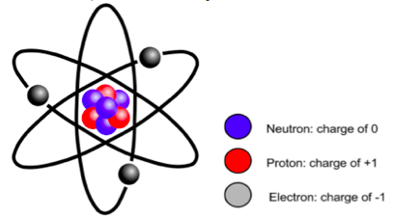
Atomic orbitals and Orbital Approximation

Slide 2
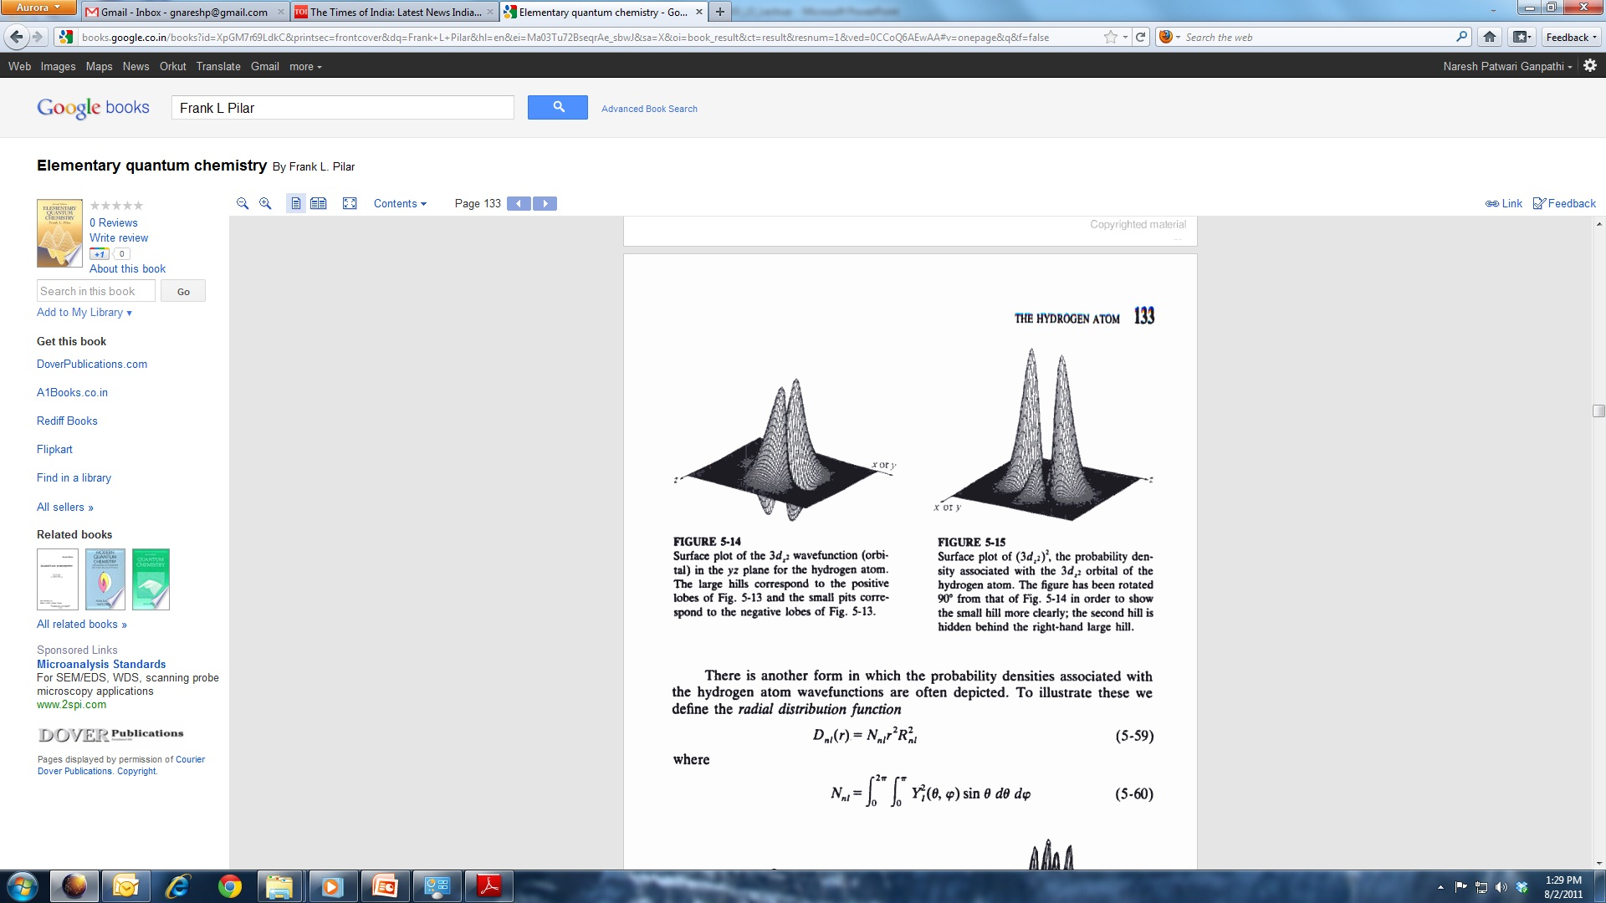
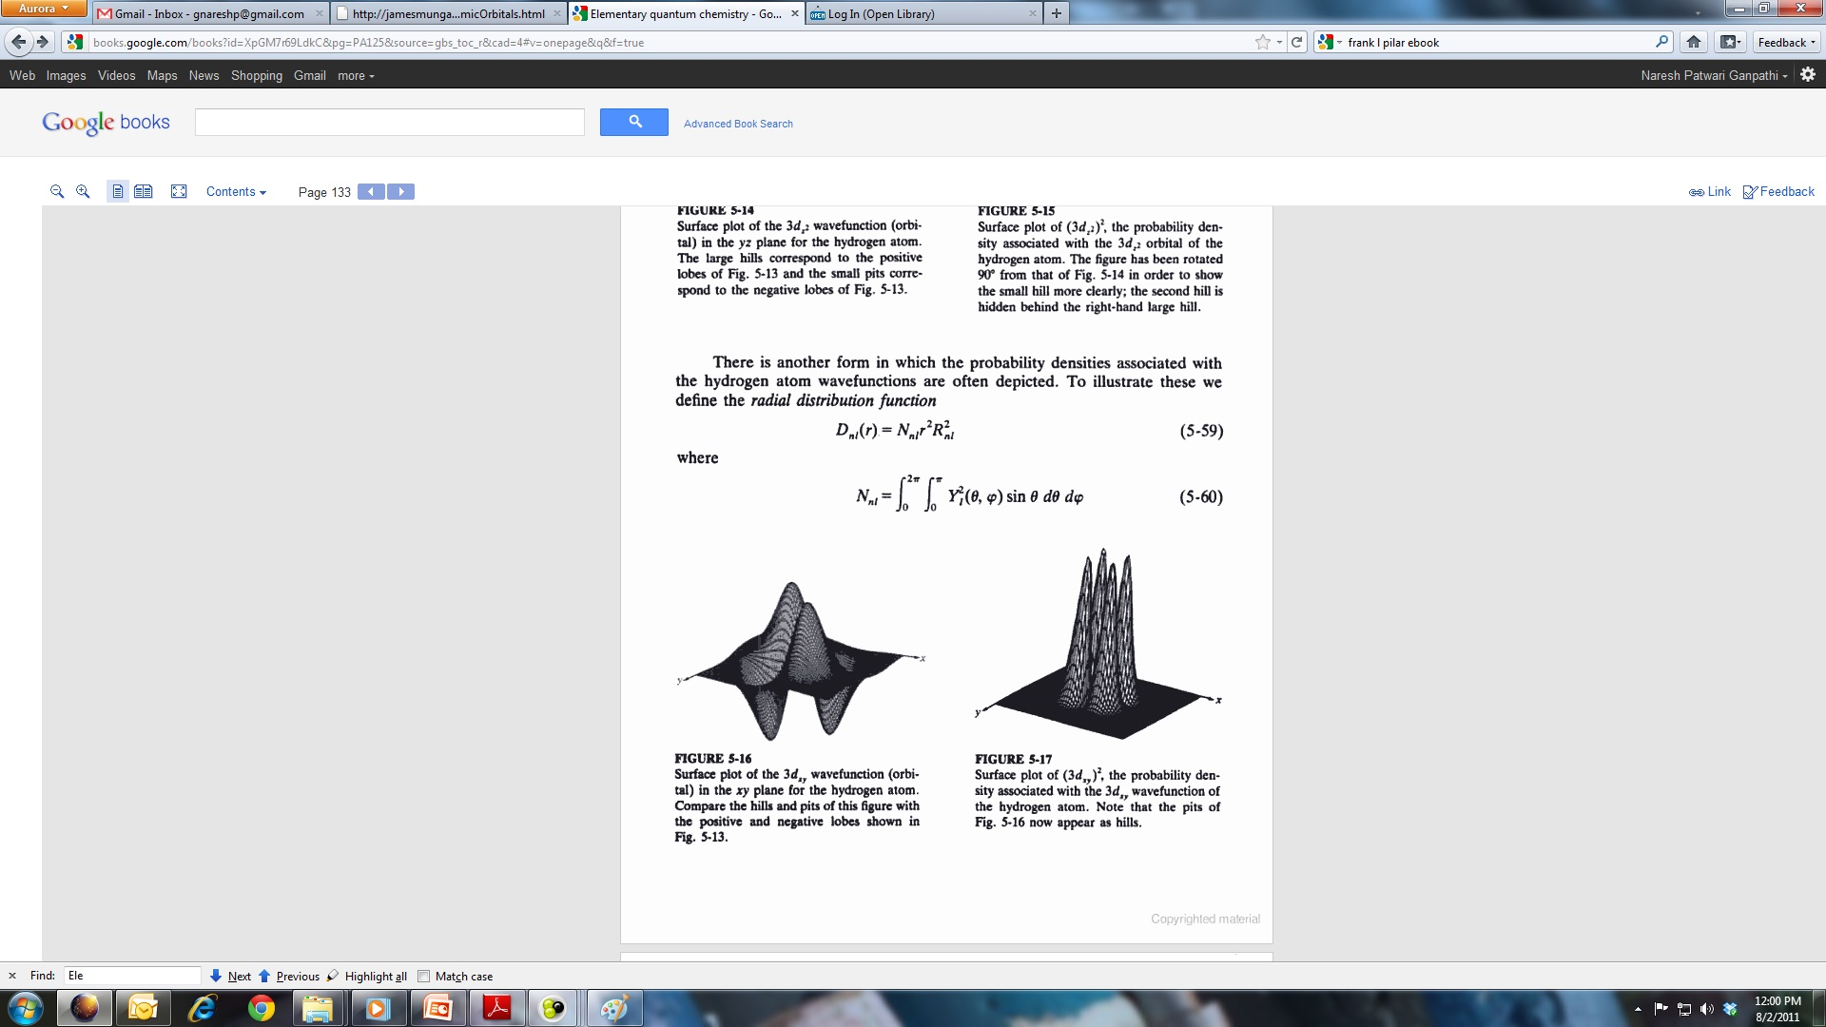
Surface plots
Surface plot of the 3d_{z2} wavefunction (orbital) in the xz (or yz) plane for the hydrogen atom. The large hills correspond to the positive lobes and the small pits correspond to the negative lobes.
Surface plot of the (3d_{z2} )² the probability density associated with the 3d_{z2} orbital of the hydrogen atom. This figure is rotated with respect to the figure on the left so that the small hill will be clearly visible. Another smaller hill is hidden behind the large hill.
Surface plot of the 3d_{xy} wavefunction (orbital) in the xz plane for the hydrogen atom. The hills and the pits have same amplitude.
Surface plot of the (3d_{xy} )² the probability density associated with the 3d_{xy} orbital of the hydrogen atom. Pits in the figure to the left appear has hills.

Slide 3
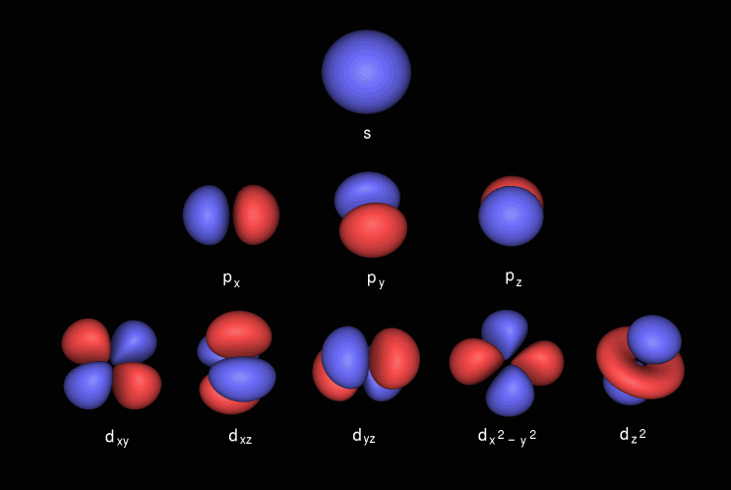
Orbitals: External Structure

Slide 4
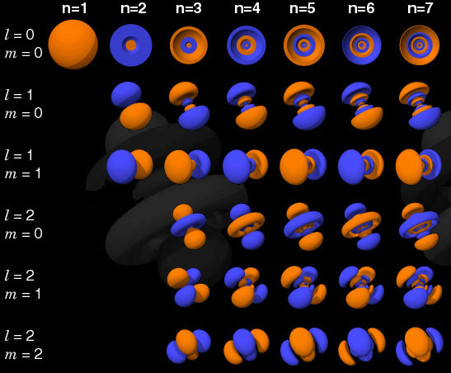
Orbitals: Internal Stucture

Slide 5
Hydrogen atom & Orbitals
Hydrogen atom has only one electron, so why bother about all these orbitals?
1. Excited states
Spectra
3. Many electron atoms

Slide 6
r₁₂= r₁- r₂
Many Electron Atoms
-
Helium is the simplest many electron atom
-
r₂
r₁

Slide 7
r₁₂= r₁- r₂
Many Electron Atoms
-
Helium is the simplest many electron atom
-
r₂
r₁
+
Attraction between nucleus and Electron1
KE of
Electron2
KE of Nucleus
Repulsion between
Electron1 and Electron2
KE of
Electron1
Attraction between nucleus and Electron1

Slide 8
Helium Atom: Separation of nucelar and electronic co-ordinates
ç√
ç√

Slide 9
Helium Atom: The electronic part
The Hamiltonians Ĥ₁ and Ĥ₂ are one electron Hamiltonians similar to that of hydrogen atom

Slide 10
Orbital Approximation
Orbital is a one electron wavefunction
The total electronic wavefunction of n number of electrons can be written as a product of n one electron wavefunctions

Slide 11
Helium Atom: Orbital Approximation

Slide 12
Helium Atom: Orbital Approximation

Slide 13
Helium Atom: Orbital Approximation

Slide 14
Helium Atom: Orbital Approximation

Slide 15
Helium Atom: Orbital Approximation
If we ignore the term
From photoelectron spectroscopy (experiment):
Ignoring is not justified! Need better approximation

Slide 16
Many Electron Atoms
, 1-electron Hamiltonians
Inter-electron repulsion terms:
CANNOT be ignored
Hamiltonian is no longer spherically symmetric and the Time-Independent Schrodinger Equation (TISE) cannot be solved using analytical techniques
Numerical methods must be used solve the TISE

Slide 17
Many Electron Atoms: Orbital Approximation
Improvement
: Interaction between the electrons.
Electron and nucleus: opposite charges
Electron and electron: Same charge
Net nuclear attraction perceived by an electron
= Actual Nuclear attraction – repulsion by other electrons
⇒ Shielding

Slide 18
Effective Nuclear Charge
For Helium atom

Slide 19
Effective Nuclear Charge
Due to Shielding, the electrons do not see the full nuclear charge Z, but Z_{eff} = Z–σ (σ = Shielding Constant)
For Helium atom
There are methods such as Perturbation Theory and Variational Method to estimate Z_{eff}

Slide 20
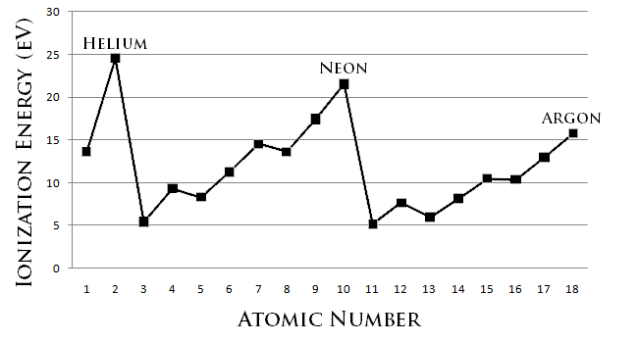
Effective Nuclear Charge
Due to Shielding, the electrons do not see the full nuclear charge Z, but Z_{eff} = Z–σ (σ = Shielding Constant)
Effective nuclear charge is same for electrons in the same orbital, but varies greatly for electrons of different orbitals (s,p,d,f) and n.
Z_{eff} determines chemical properties of many electron atoms

Slide 21
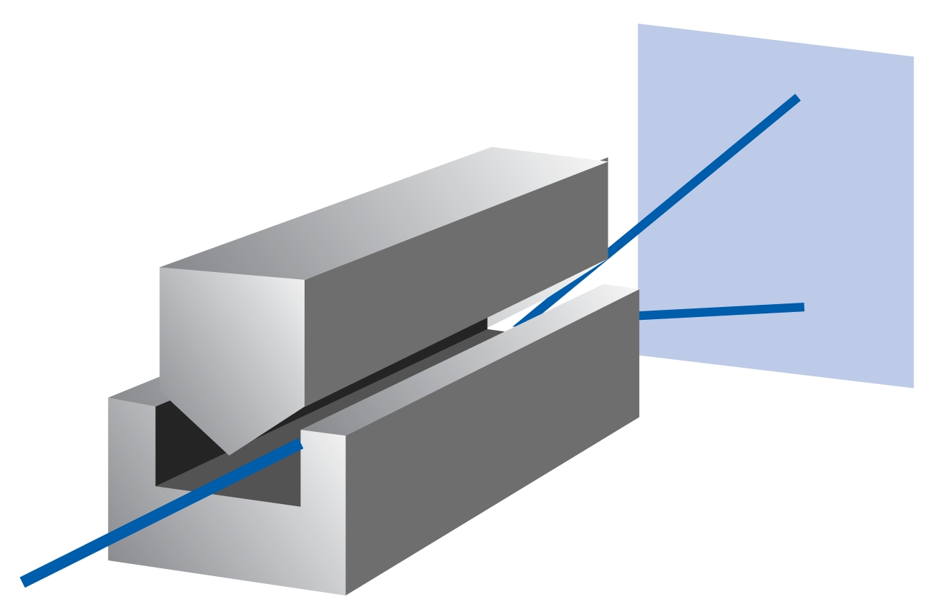
“Spin” of an electron
Stern-Gerlach Experiment (1922):
Beam of Ag atoms (4d¹⁰ 5s¹) passed through an inhomogeneous magnetic field: TWO lines
Uhlenbeck and Goudsmit (1925): Two angular momentum states, Intrinsic to the electron
NOT a result of actual rotation (v >c !!)
Spin: S(ω), ω is an unknown coordinate
Dirac: Relativistic quantum mechanics

Slide 22
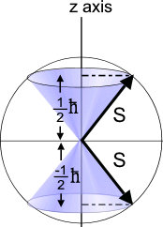
Spin Angular Momentum
Spin Angular Momentum “S’’
For electrons, s = 1⁄2
“spin-up” (or α) and “spin-down” (or β)

Slide 23
Hydrogen Atom Wavefunctions: Redefined
Incorporate “spin” component to each of the 1-electron wavefunctions: SPIN ORBITALS
Total wavefunctions = product of spatial and spin parts
Each atomic orbital now becomes doubly degenerate
Spin orbitals are orthogonal and normalized. Quantum numbers are n,l,m,m_{s}
SPIN ORBITAL: One electron wavefunction containing spatial as well as spin parts

